Slide 1
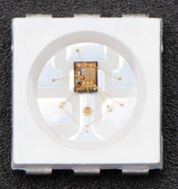
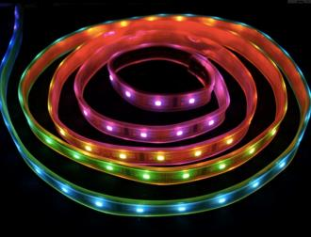
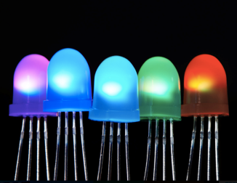
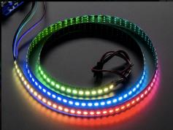
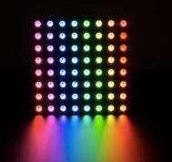
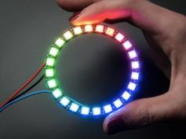
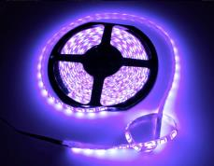
LED Options
ECE 411 PROJECT / Carmen Ciobanu

Slide 2
LED Technologies Comparison (Product ID on www.adafruit.com)
Category | Driver Type | Form | Product ID | Power | Dimensions | # LEDs | Driver | Price
Neo Pixels | WS2812 | Pixels | 1379, 1655, 1260, 1559 | 5V 60 mA /pixel | 5mm x 5mm | 4, 10, 20 pack | 1 data line / Strict timing protocol | $ 4.50 – $34.95
 |  | Stick | 1426 | 5V 60 mA /pixel | 2" x 0.4" x 0.12" | 8 LEDs/ stick | 1 data line / Strict timing protocol | $ 5.95
 |  | Ring | 1586, 1643, 1463, 1768 | 5V 60 mA /pixel | 1.5”, 1.75”, 2.6”, 6.2” diameter | 12, 16, 24 60 LEDs | 1 data line / Strict timing protocol | $ 7.50 – $ 19.95
 |  | Strip | 1376, 1460, 1461, 1138 1506, 1507 | 5V/ 2A / 1m 5V/ 3.5A/1m 5V/7 A 1m | 1 m 1 m 1 m | 30 / 1m 60 / 1 m 144 / 1m | 1 data line / Strict timing protocol | $ 16.50 $ 24.95 $ 59.95
 |  | Matrix | 1487 | 5V / 2A | 2.8" x 2.8" x 0.12" | 8 x 8 = 64 LEDs | 1 data line / Strict timing protocol | $ 34.95
 | WS2811 | 5 mm LED | 1938 | 5 V | 5mm diameter Through-Hole | 5 pack | 1 data line / Strict timing protocol | $ 4.95
 |  | 8 mm LED | 1734 | 5 V | 8mm diameter Through-Hole | 5 pack | 1 data line / Strict timing protocol | $ 4.95
Digital RGB LED pixels | WS2801 | 12 mm pixels | 322, 738 | 5V / 2A | 12 mm diameter | Strand (25) | 2-pin SPI-like protocol PWM driver | $ 39.95
 |  | 36 mm pixels | 683, 1547, 1548 | 12V / 5A | 36 mm x 36 mm squares, 30 mm diameter | Strand (20) | 2-pin SPI-like protocol PWM driver | $ 49.95 - $64.95
Digital RGB LED strips | LPD8806 | Strip | 306, 1948 | 5V / 2A | 16mm / 4mm / 1m | 32 / 1m 48 / 1 m | 2-pin SPI-like protocol PWM driver | $ 29.95 - $34.95
Analog RGB LED | N/A | 5 mm LED | 159, 302 | 1.9V -2.5V/ 20mA | 5mm diameter Through-Hole | Single 25 /pack |  | $ 2.00 / each $19.95 / 25 pack
 |  | Strip | 346, 285 | 12 V / 5 A | 10.5mm/3mm/1m | 30, 60 / 1m | PWM for color mixing | $ 16.00 - $25.00

Slide 3
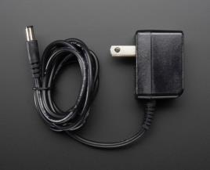
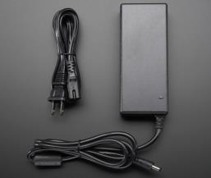
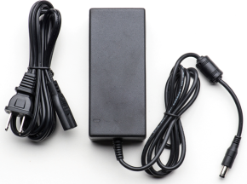
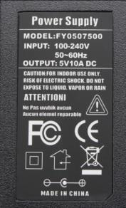
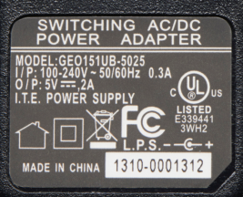
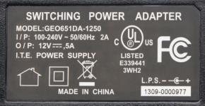
Power options from Adafruit
ID: 276 (5V/2A) ID: 658 (5V/10A) ID: 352 (5V/10A)
5V/2A switching power supply ($7.95) 5V/10A switching power supply ($25.00) 12V/5A switching power supply ($24.95)

Slide 4
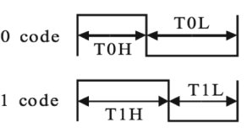

Drivers
Neo Pixel | Digital RGB pixels / strips | Analog LED strip
1 wire protocol No separate clock line Strict timing protocol Potentially very complicated | 2-pin SPI-like protocol Clock and data lines PWM code 7-bit PWM precision (21-bit color per pixel) | No protocol needed PWM for color mixing

Slide 5
Other Considerations:
Neo Pixels and digital RGB pixels and strips need a controller speed > 8 MHz (preferably 16 or 20 MHz)
Neo Pixels and digital RGB pixels and strips need to have sufficient RAM (the more pixels, the more RAM needed)

